Slide 1
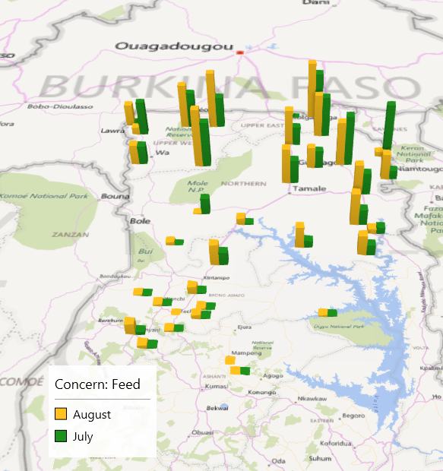
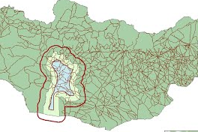
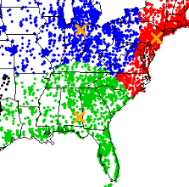
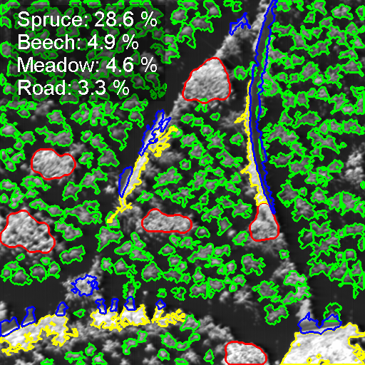
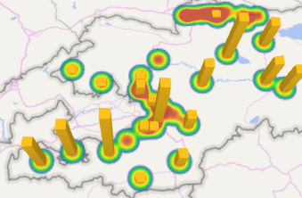

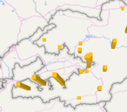
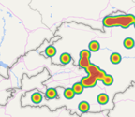
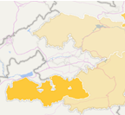
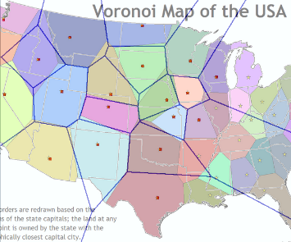
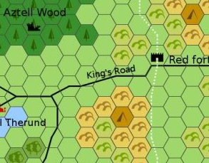
Spatial Analysis
What:
How:
Putting your data on maps!
Latitude/Longitude OR Geocoding
Why:
Who:
Because the location can be relevant!
GIS Specialist / general analyst*
(Some stuff)
… as a Visual aid
… for analysis/modelling
Buffer area
How many villages are within 10km of lake?
Cluster Analysis
Rem. Sensing
Correlations
Are these two variables related?
Which area didn’t get equal training?
Generate 3 categories based on empirical data
What is the makeup of this forest?
Types of maps:
Points
Heatmap
Choropleth
Other (Voronoi, Hex map, …)
Did you know you can easily make maps in Excel? Please see our “Working with Geographic Information: Task breakdown” briefer for more information!

